Slide 1

Candidate Package

Slide 2
Overview
You will have received 3 datasets containing account, customer, and transaction level data. We are interested in understanding the process you take in answering the following questions. Please provide the answer and an explanation where applicable. Questions are broken into two categories:
Data Manipulation Queries
These are questions designed to test your understanding of data manipulation and preparation. Please provide the answer to the question on the Data Manipulation answer slide (slide 5) and provide your queries in the corresponding Data Manipulation queries slides. You can use any programming language you would like to complete the task.
Business Case
These questions are designed to test your critical thinking, logic, and problem solving skills. Please document your approach and present your findings as if you were presenting to an executive (non-technical) business partner. You can use any programming language you would like to complete the task.
**NOTE**: Please complete your work and include your findings in this deck and send back the completed deck saved as CandidatePackage_TD_LASTNAME_FIRSTNAME. Also submit the code used to complete your tasks (e.g. Jupyter notebook, R code, etc.).

Slide 3
Your Task
Data Manipulation
What branch has most number of customers?
How old is the oldest customer as of 2019-07-01
How many accounts does the oldest customer have?
How many transactions went to Starbucks in April?
How much was spent on Starbucks in April?
Hypothesis Testing: Is the average spend at Starbucks (statistically) significantly different in April compared to June?
Which date exhibited the highest average spend above trend at Starbucks (based on a 10-period moving average, ignoring missing dates)?

Slide 4
1
Data Manipulation Questions

Slide 5
Data Manipulation Query Answer Summary Page
What branch has most number of customers?
ANSWER: 1029
How old is the oldest customer as of 2019-07-01?
ANSWER: 107
How many accounts does the oldest customer have?
ANSWER: 2
How many transactions went to Starbucks in April?
ANSWER: 395
How much was spent on Starbucks in April?
ANSWER: 1720.87
Hypothesis Testing: Is the average spend at Starbucks (statistically) significantly different in April compared to June?
ANSWER: No
Which date exhibited the highest average spend above trend at Starbucks (based on a 10-period moving average, ignoring missing dates)?
ANSWER: 2018-06-22

Slide 6
Data Manipulation Query 1: Branch with most customers
select branchNumber, count(id) from accts group by branchNumber order by count(id) desc LIMIT 1;
Output : 1029

Slide 7
Data Manipulation Query 2: Oldest customer as of 2019-07-01
SELECT id, right(birthdate,4) FROM Custs Order BY right(birthdate,4);
Output : 1912
SELECT birthdate FROM Custs where id = 'fe51c153-fbec-4b64-9b00-2530035ef0e1_522519ff-5e56-4d8a-9888-560f2cde4938’;
Output : 10/22/1912
Select DateDiff(year,'10/22/1912','2019/07/01') as DateDiff
Output : 107 years

Slide 8
Data Manipulation Query 3: Oldest customer number of accounts
Select a.id, a.type, b.birthdate from accts as a left join custs as b on a.cust_id = b.id where b.birthdate = '10/22/1912’
Output : 2
fe51c153-fbec-4b64-9b00-2530035ef0e1_cbe429f1-7684-4361-b69f-3903699e2a85 | DDA | 10/22/1912
fe51c153-fbec-4b64-9b00-2530035ef0e1_d8819f65-afba-4c15-9142-a564296df07a | SDA | 10/22/1912

Slide 9
Data Manipulation Query 4: Transactions to Starbucks
Select count(*) from trans where description like '%STARBUCKS%' and originationDateTime like '2018-04%’
Output : 395

Slide 10
Data Manipulation Query 5: Dollars spent at Starbucks
Select left(description,9) as Description, sum(currencyAmount) from trans where originationDateTime like '2018-04%' group by left(description,9) having left(description,9) like '%STARBUCKS%’
Output : 1720.87

Slide 11
Data Manipulation Query 6: Hypothesis Test - Starbucks April and June statistical significance spend comparison
Assuming the null hypothesis : There is no significant difference in the April Expenditure vs June 2019.
Average Spent for April in Starbucks
Select left(description,9) as Description, avg (currencyAmount) from trans where originationDateTime like '2018-04%' group by left(description,9) having left(description,9) like '%STARBUCKS%’
Output : 4.35
Average Spent for June in Starbucks
Select left(description,9) as Description, avg (currencyAmount) from trans where originationDateTime like '2018-06%' group by left(description,9) having left(description,9) like '%STARBUCKS%’
Output : 4.49
The difference is 14 cents. Which is not significant dollar value. Hence, we fail to reject the Null Hypothesis

Slide 12
Data Manipulation Query 7: Highest average spend above trend at Starbucks (based on a 10-period moving average, ignoring missing dates)
select left(originationDateTime,10) as Date, avg(currencyAmount) over (order by originationDateTime ROWS 9 PRECEDING) as moving_average from trans where left(description,9) like '%STARBUCKS%' order by moving_average desc LIMIT 1;
Output : 2018-06-22
2018-06-22 | 6.351

Slide 13
2
Business Case

Slide 14
Your Task
Business Case
Use the data provided to answer the following questions:
We are planning to launch a new product focused on a specific merchant category (e.g. travel credit card). Which specific merchant category would you like to focus on for this new product? Please explain your rationale for this category incorporating both the insights derived from the data and other concepts where you see fit.
Identify and describe various segments of customers within the data. Consider applying segmenting/clustering techniques to aid in the development of your answer.
Of the segments that you created in question 2, which specific segment would you like to target for this new product? Why would you target them? What are the potential challenges/risks to consider when targeting this segment vs. others?

Slide 15
Approach
Joining the Tables of Customer and Transaction, I will perform some exploratory data analysis on Category tags and other variables like gender, workActivity, occupationIndustry, totalincome etc.
Using Box Plot on Currency amount for different category tags will identity the highest values transactions for each category, which will help in identifying the new product opportunities.
Using DBScan (Density-based spatial clustering), I will try to identify the possible clusters of the customers, that shall be targeted for the new credit card product
Population with no income is filtered out. Variables used for DBScan are Age, Income & Transaction amt.

Slide 16
3
Executive Presentation (Business Case Answers)

Slide 17
Executive Summary
Proposal to Introduce a new card for Billing and Utilities
Full Time employees spend a major chunk of their expenses in Billing and Utilities
Retirees spend the most on Billing and Utilities and they will be our target cluster.
Target Customers (in Bills and Utilities)
Average age : 62
Average Income : CAD 56762
Average transaction : CAD 67

Slide 18
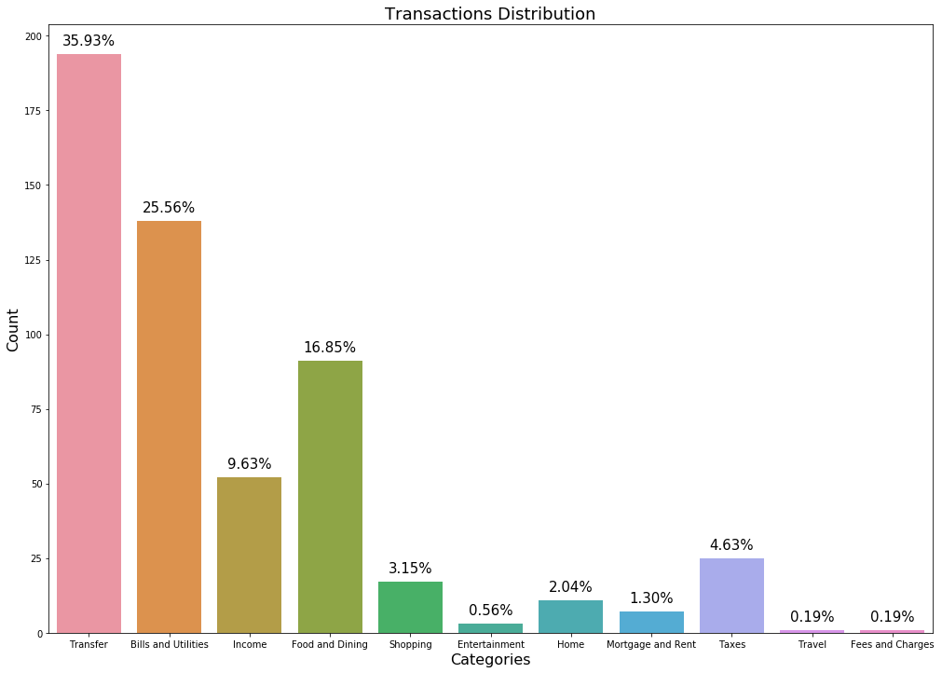
Presentation of Findings (Question 1)
25% Transactions are allocated to Bills and Utilities, which is a good means to use a credit card.

Slide 19
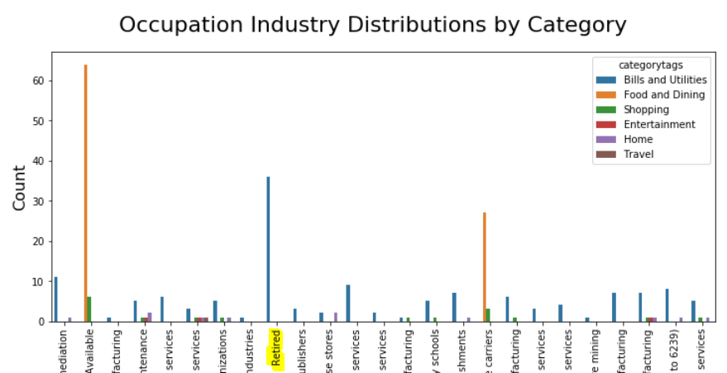
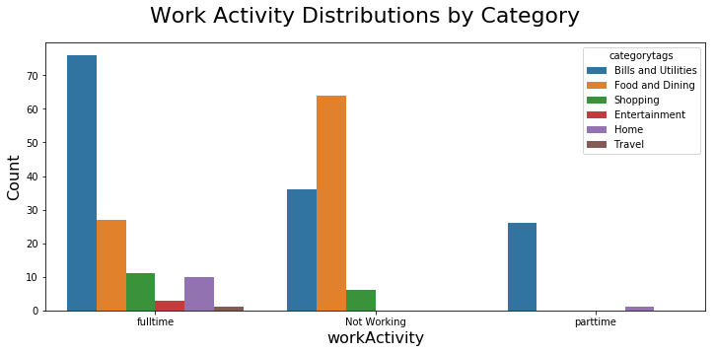
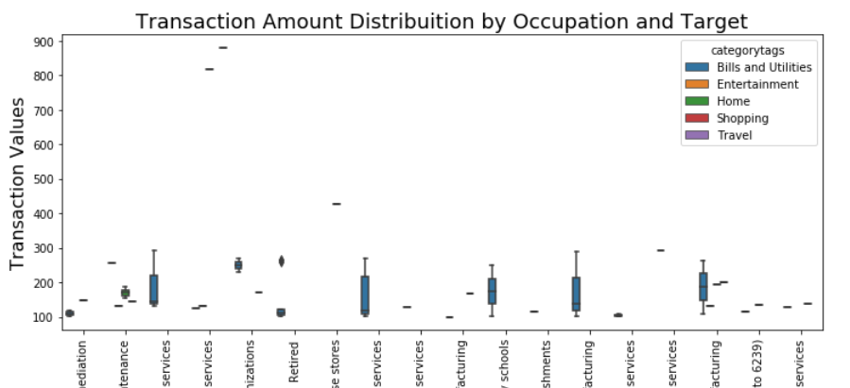
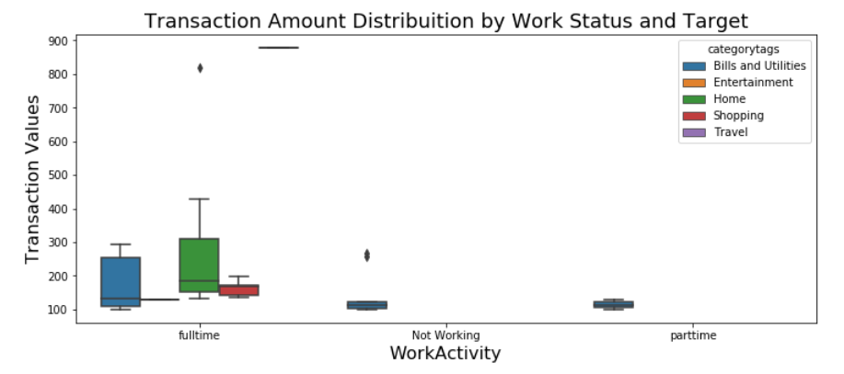
Presentation of Findings (Question 1)
Retirees spend the most on Billing and Utilities
Full Time employees spend a major chunk in Billing and Utilities

Slide 20
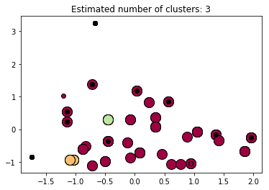
Presentation of Findings (Question 2)
Cluster 1: Avg Age: 62, Avg Income: 56762, Avg Spending: 67, Count: 99
Cluster 2: Avg Age: 38, Avg Income: 18788, Avg Spending: 20, Count: 8
Cluster 3: Avg Age: 49, Avg Income: 81900, Avg Spending: 31, Count: 6

Slide 21
Presentation of Findings (Question 3)
Target Customers
Average age : 62
Average Income : CAD 56762
Average transaction : CAD 67
These are the segments with higher incomes and average spending in transfers is significant. A new launch for such cards will increase these transaction values.
Challenges and Risks in this segments
Need more indicators. At Present I am only using Age, Income and transaction.
Cluster 3 is a good candidate (Age:49.0, Avg Income: CAD 81900, Avg Transaction: CAD 31) However most % of retired populations have high balances in Bills and Utilities.
The Cluster range is too small for a new launch. This will scale down the list of final customers that will be targeted towards the launch. There is a risk of loosing some potential customers from other segments / clusters including the high net worth individuals

